Slide 1
Intermediate RStudio Training
December 13, 2017

Slide 2
Course Outline
Productivity features
Essential data skills
Factors
Descriptive statistics
Covariances and correlations

Slide 3
Productivity in RStudio

Slide 4
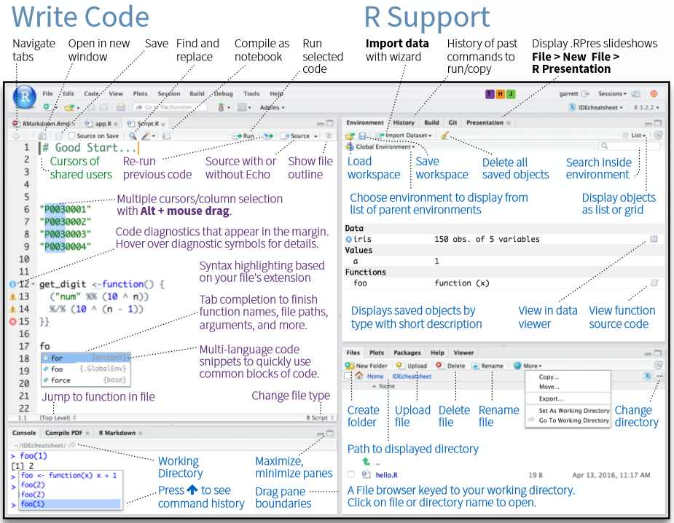
RStudio Cheat Sheet

Slide 5
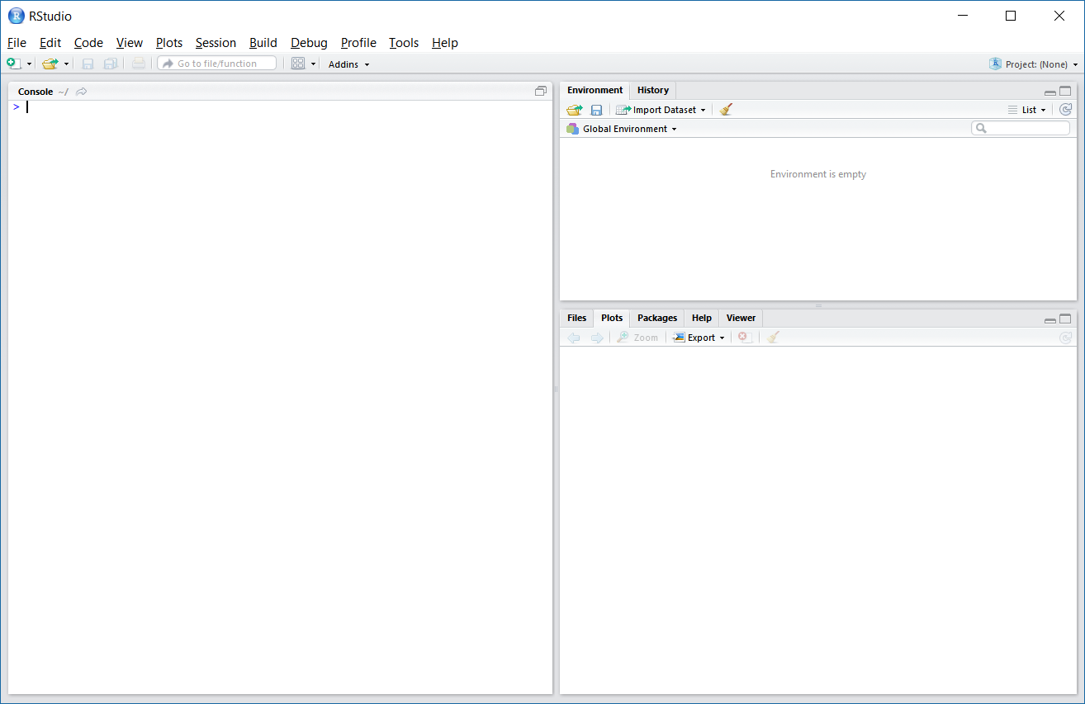
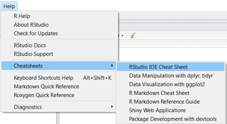
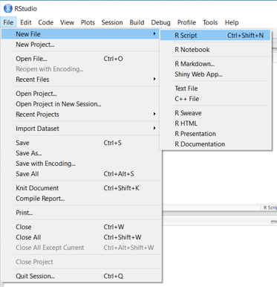
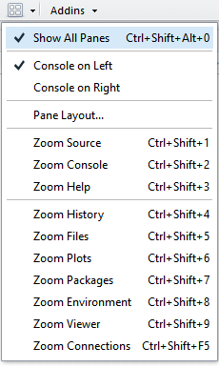
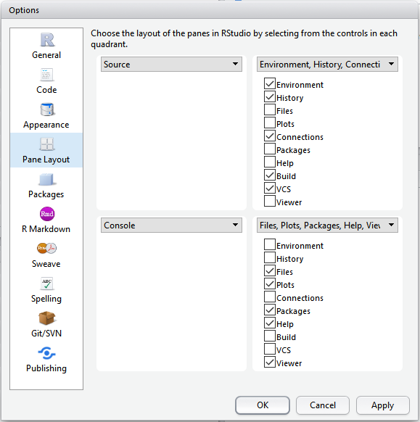
Customizing RStudio

Slide 6
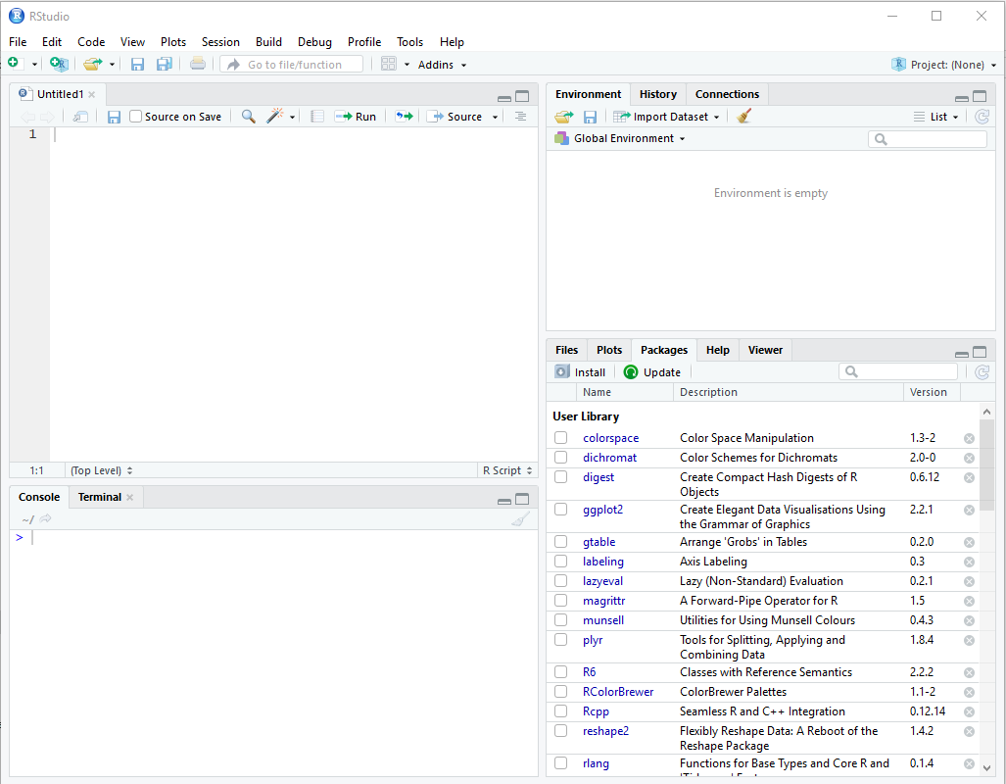
Scripting Window
Open window:
File => New File => R Script (CTRL + SHIFT +N)
Save file: CRTL + S
Note: Do not save entire working directory in DSVD, use this method to save your scripts

Slide 7
Auto-completion in RStudio
Tab is a generic auto-complete function. If you start typing in the console or editor and hit the tab key, RStudio will suggest functions or file names; simply select the one you want and hit either tab or enter to accept it.
Control + the up arrow (command + up arrow on a Mac) is a similar auto-complete tool. Start typing and hit that key combination, and it shows you a list of every command you've typed starting with those keys. Select the one you want and hit return. This works only in the interactive console, not in the code editor window.
Control + enter (command + enter on a Mac) takes the current line of code in the editor, sends it to the console and executes it. If you select multiple lines of code in the editor and then hit ctrl/cmd + enter, all of them will run.

Slide 8
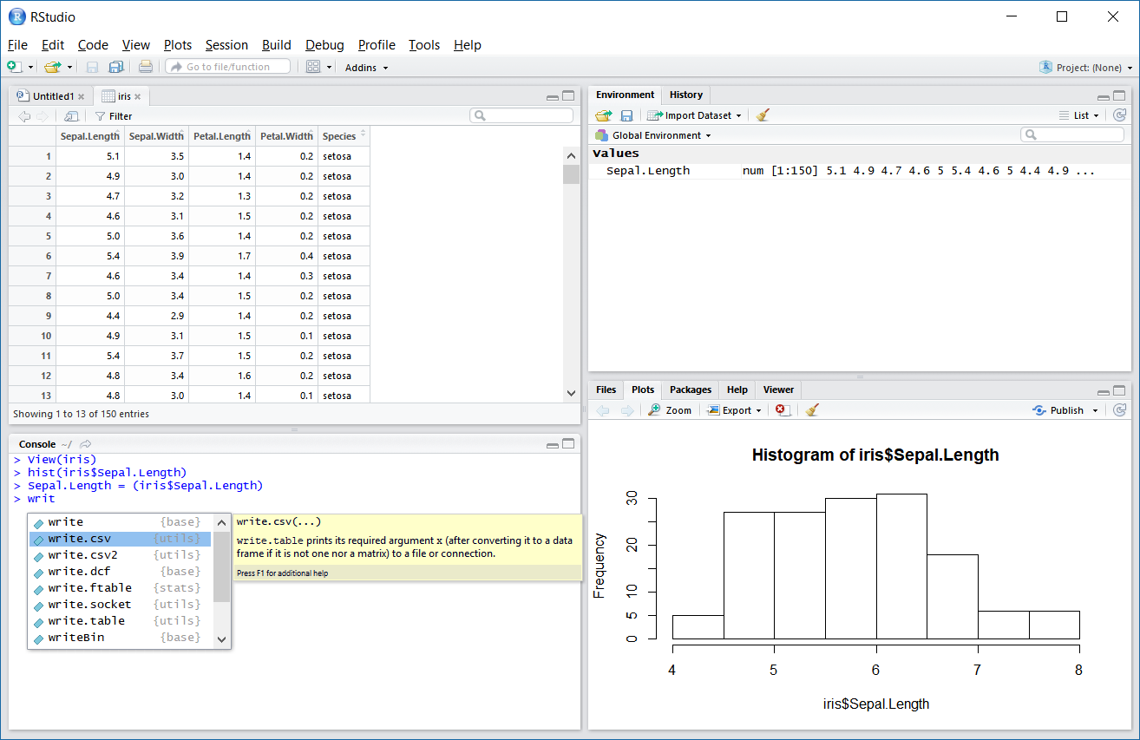

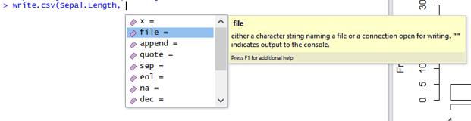
Exercise 1: Auto-completion

Slide 9
Essential Data Skills

Slide 10
Connect to MySQL in DSVD
Establish connection
> library(DBI)
> library(RMySQL)
> mysqlconnection = dbConnect(MySQL(), user = 'd2dtraining_user', password='rT788h@vL!bbV', dbname='GSA_D2D_Training', host ='dc1dbeywj57czbx.c1q8kedtqajq.us-east-1.rds.amazonaws.com')
Read tables
> dbListTables(mysqlconnection)
[1] "pseudo_facebook" "reddit"
[3] "statesDataForIntermediateR"
Create R object
> statesData = dbSendQuery(mysqlconnection, "select * from statesDataForIntermediateR")
Convert object to data frame
> dataFrame = fetch(statesData)
> print(dataFrame)s, or
> View(dataFrame)
Will be disabled after training
Replace with your own credentials / schema name

Slide 11
Read, Dim, Write
Read in data
> statesInfo = read.csv("C:\\Users\\mashk\\Desktop\\R Training\\statesDataForIntermediateR.csv")
Assess the data
> dim(statesInfo)
[1] 50 12
> class(statesInfo)
[1] „data.frame“
Write data
> write.csv(statesInfo, file = „statesInfo.csv“)
Find your file
> getwd()
Replace “\”
with “/” or “\\”

Slide 12
Factors and Factor Levels
str() – compactly display the internal structure of an R object
Factor – a (categorical) variable with a discrete set of values
Level - a value a qualitative (categorical) variable can take
> str(iris)
'data.frame': 150 obs. of 5 variables:
$ Sepal.Length: num 5.1 4.9 4.7 4.6 5 5.4 4.6 5 4.4 4.9 ...
$ Sepal.Width : num 3.5 3 3.2 3.1 3.6 3.9 3.4 3.4 2.9 3.1 ...
$ Petal.Length: num 1.4 1.4 1.3 1.5 1.4 1.7 1.4 1.5 1.4 1.5 ...
$ Petal.Width : num 0.2 0.2 0.2 0.2 0.2 0.4 0.3 0.2 0.2 0.1 ...
$ Species : Factor w/ 3 levels "setosa","versicolor",..: 1 1 1 1 1 1 1 1 1 1 .

Slide 13
Subset Data Frame
Select rows with [ ]
> iris[1:5, ]
Select columns with [ ]
iris[, c("Sepal.Length", "Sepal.Width")]
subset() function
StatesRegion1 = subset(statesInfo, state.region == 1)
diamonsSelected = subset(diamonds, cut == "Ideal" & color == "E")
dsPrice2 = subset(diamonds, cut == "Ideal" & color == "E", c("price", "clarity" ))
irisPetalData = subset(iris, select = -c(1,2))
Can specify Column after “,”
Use c() for multiple Columns
All Columns if empty
Drop Columns by number

Slide 14
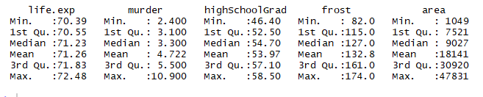
Descriptive Statistics
R provides a wide range of functions for obtaining summary statistics.
Built-in functions sd(), mean(), median(), max/min(), e.g.:
mean(x, trim = 0, na.rm = FALSE)
> mean(iris$Sepal.Length)
[1] 5.843333
> mean(iris$Sepal.Length, trim = .05)
[1] 5.820588
summary()
summary(StatesRegion1)
Quartiles:
1stQu or lower quartile, is the value that cuts off the first 25% of the data when it is sorted in ascending order. i.e. 70.55 life.exp means that 25% live less than 70.55 years.
second quartile, or Median, is the value that cuts off the first 50%
3rdQu , or upper quartile, is the value that cuts off the first 75%
na – not available
rm - remove

Slide 15
Covariances and Correlations
Same syntax for both
Correlation between x and y
cor(x,y), cov(x,y)
Optional parameters
Use
A character string giving a method for computing in the presence of missing values. This must be (an abbreviation of) one of the strings "everything", "all.obs", "complete.obs", "na.or.complete", or "pairwise.complete.obs“
Correlation with missing data
cor(x,y, use = “complete”)
Method
A character string indicating which correlation coefficient (or covariance) is to be computed. One of "pearson" (default), "kendall", or "spearman":
> cor(iris$Sepal.Length, iris$Petal.Length)
[1] 0.8717538
> cor(iris$Sepal.Length, iris$Petal.Length, method = "kendall")
[1] 0.7185159
> cor(iris$Sepal.Length, iris$Petal.Length, method = "spearman")
[1] 0.8818981
> cov(iris$Sepal.Length, iris$Petal.Length, method = "spearman")
[1] 1661.304
If x is a matrix, then y is NULL and syntax is
cor(x)

Slide 16
Correlation Test
Can be based on Pearson, Kendall or Spearman
Returns correlation coefficient and p-value (significance level)
> cor.test(iris$Sepal.Length, iris$Petal.Length)
Pearson's product-moment correlation
data: iris$Sepal.Length and iris$Petal.Length
t = 21.646, df = 148, p-value < 0.00000000000000022
alternative hypothesis: true correlation is not equal to 0
95 percent confidence interval:
0.8270363 0.9055080
sample estimates:
cor
0.8717538

Slide 17
Pearson Vs Kendal and Spearman
Most commonly used is Pearson method
Pearson correlation measures linear dependence between two normally distributed variables when change in one variable causes proportional change in another
Kendal and Pearson are rank-based correlation coefficients, i.e. the data point are first ranked and the correlation of the ranks is measured
Kendal and Pearson can be used for ordinal data, e.g. correlation between test scores and months of training

Slide 18
ggplot2
“ggplot2 is the most elegant and aesthetically pleasing graphics framework available in R. It has a nicely planned structure to it.”
http://r-statistics.co/ggplot2-Tutorial-With-R.html
ggplot2 works with data frames and not individual vectors
You can keep enhancing the plot by adding more layers (and themes) to an existing plot created using the ggplot() function

Slide 19
ggplot2 Cont.
Setup
options(scipen=999) # turn off scientific notation like 1e+06
library(ggplot2)
data("midwest", package = "ggplot2")
Initiate
ggplot(midwest, aes(x=area, y=poptotal))
Scatter Plot
ggplot(midwest, aes(x=area, y=poptotal)) + geom_point()
Smoothing layer
g <- ggplot(midwest, aes(x=area, y=poptotal)) + geom_point() + geom_smooth(method="lm")
plot(g)
Adjust axis by deleting out of range points
g + xlim(c(0, 0.1)) + ylim(c(0, 1000000))
Change labels
g1 <- g + coord_cartesian(xlim=c(0,0.1), ylim=c(0, 1000000))
g1 + labs(title="Area Vs Population", subtitle="From midwest dataset", y="Population", x="Area", caption="Midwest Demographics")

Slide 20
ggplot2 Cont. 2
Change color and size of points
ggplot(midwest, aes(x=area, y=poptotal)) +
geom_point(col="steelblue", size=3) + # Set static color and size for points
geom_smooth(method="lm", col="firebrick") + # change the color of line
coord_cartesian(xlim=c(0, 0.1), ylim=c(0, 1000000)) +
labs(title="Area Vs Population", subtitle="From midwest dataset", y="Population", x="Area", caption="Midwest Demographics")
Change the Color To Reflect Categories in Another Column
gg <- ggplot(midwest, aes(x=area, y=poptotal)) +
geom_point(aes(col=state), size=3) +
geom_smooth(method="lm", col="firebrick", size=2) +
coord_cartesian(xlim=c(0, 0.1), ylim=c(0, 1000000)) +
labs(title="Area Vs Population", subtitle="From midwest dataset", y="Population", x="Area", caption="Midwest Demographics")
plot(gg)

Slide 21
Q & A

